Slide 1
Linear Independence and Basis of Vector Spaces

Slide 2
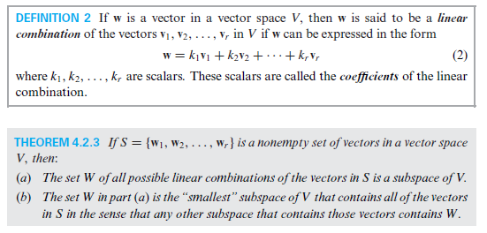







Slide 3
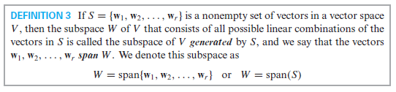

Slide 4
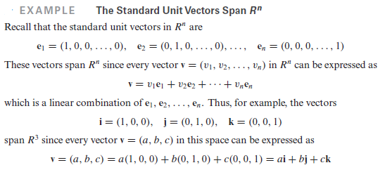






Slide 5
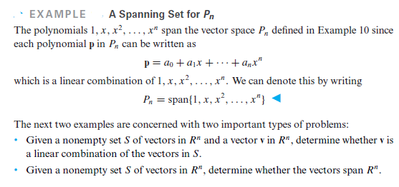







Slide 6





















Slide 7






















Slide 8



























Slide 9




















Slide 13























Slide 14















Slide 15

















Slide 16
























Slide 17


























Slide 18






Slide 20
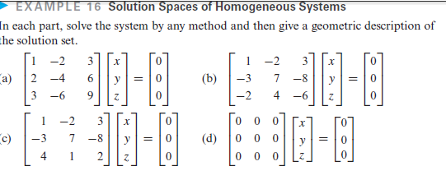

Slide 21
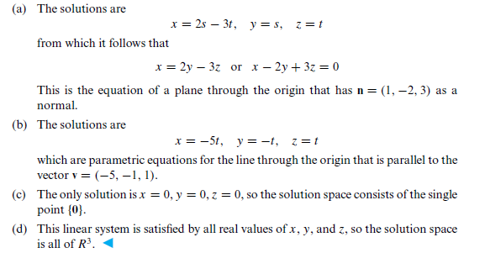

Slide 23













Slide 24
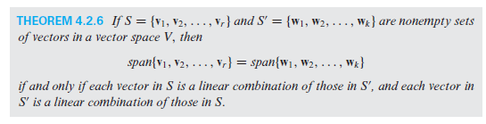

Slide 25
























Slide 26
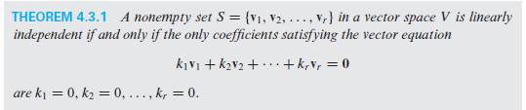

Slide 33
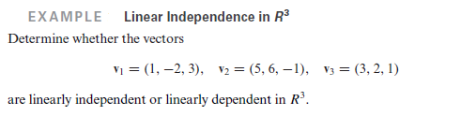

















Slide 34






























